Slide 1
Abraham G
GNU Compiler Collection
December 12nd 2017
Explained from source to exe

Slide 2

ANSI C
The C programming language was created by Dennis Ritchie back in 1972 to re-implement the UNIX operative system. C is based on Ken Thompson's earlier B interpreter which had in turn been modeled on BCPL (Basic).
Throughout the years, the American National Standards Institute and the International Organization for Standardization have published several definitions of the standard for the C programming language, they receive the name according to the year they were published:
C89
C90
C95
C99
C11
Each revisión has new features and characteristics such as support for additional data types and functions for portability, etc.

Slide 3

ANSI C
Why is it important to have a standard for a programming language?
Allows programmers to learn only a handful of instructions and functions.
Allows the code to be portable, meaning that it can be executed in different computers with few or no changes.
Allow compilers and processors to be compatible.
Prevents Juan Perez from adding or removing functions as he pleases and say that he’s still using only C standard functions.

Slide 4

C
Standard
Libraries
FTW

Slide 5
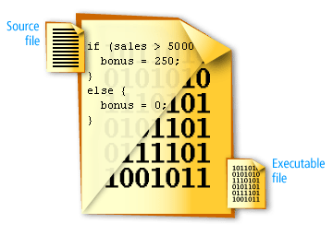
What is a compiler
A compiler is computer software that transforms computer code written in one programming language (the source language) into another programming language (the target language).
Compilers are a type of translator that support digital devices, primarily computers.
The name compiler is primarily used for programs that translate source code from a high-level programming language to a lower level language (e.g., assembly language, object code, or machine code) to create an executable program.

Slide 6

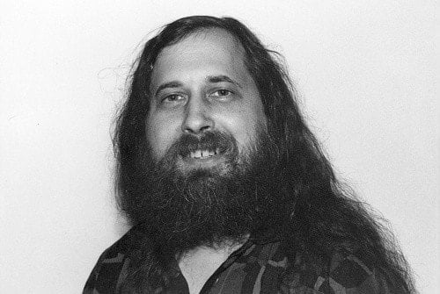
The GNU Project
The GNU Project /ɡnuː/ (About this sound listen) is a free-software, mass-collaboration project, first announced on September 27, 1983 by Richard Stallman at MIT.
Its aim is to give computer users freedom and control in their use of their computers and computing devices, by collaboratively developing and providing software that is based on the following freedom rights: users are free to run the software, share it (copy, distribute), study it and modify it.

Slide 7
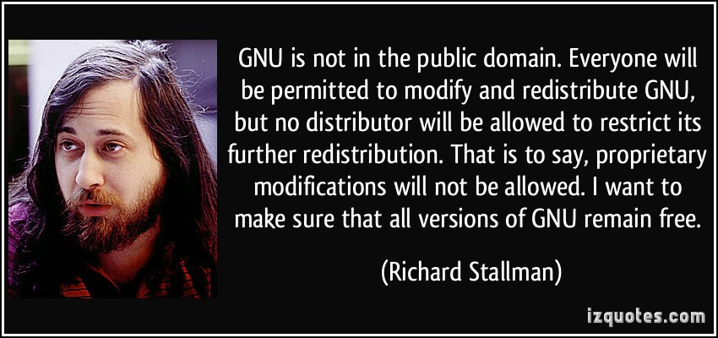
The GNU Project

Slide 8

The GNU Compiler Collection
The GNU Compiler Collection (GCC) is a compiler system produced by the GNU Project supporting various programming languages.
GCC is a key component of the GNU toolchain and the standard compiler for most Unix-like Operating Systems.
First released in 1987 as “GNU C compiler”.
More front ends were added later for:
C++
Objective C
Fortran
Ada
Java
Go
etc

Slide 9
Why using GCC
It's goal then (and even today) was to be a useful compiler for general use (see A Brief History of GCC). It was desirable that the compiler be retargetable to facilitate easy porting to new systems.
The design and development goals are:
New languages
New optimizations
New targets
Improved run time libraries
Faster debug cycle
Various other infrastructure developments

Slide 10
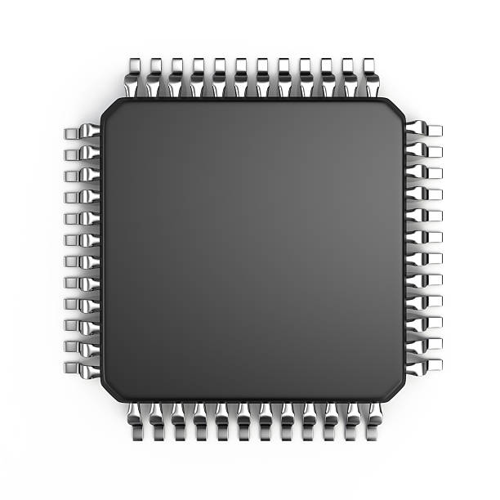
Why using GCC
Some of the supported architecture platforms:
aarch64 alpha arc arm avr bfin c6x cr16 cris epiphany fr30 frv h8300 i386 ia64 iq2000 lm32 m32c m32r m68k mcore mep microblaze mips mmix mn10300 moxie msp430 nds32 nios2 nvptx pa pdp11 riscv rl78 rs6000 rx s390 sh sparc spu stormy16 tilegx tilepro v850 vax visium xtensa.
Wide variety of IDE’s based on gcc:
Atollic TrueStudio, Code::Blocks, Netbeans, Eclipse CDT, MPLABX, Etc.
Plus an extensive community continuously providing bug fix, improvements and a lot of Stack Overflow posts.

Slide 11
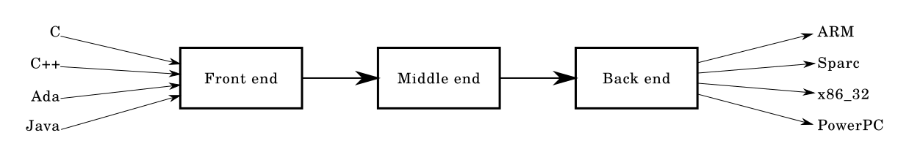
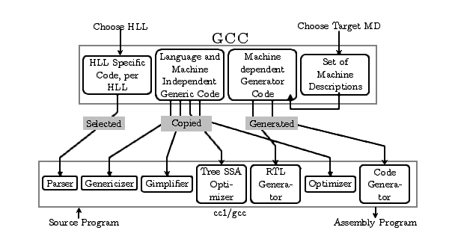
GCC at a glance

Slide 12
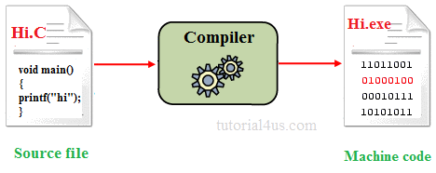
LAB1 – Hello

Slide 13
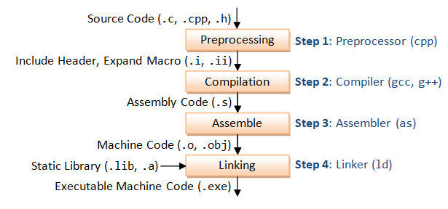
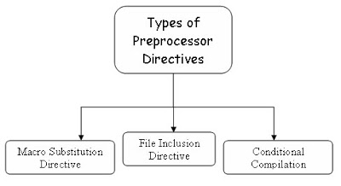
What did GCC do?
Preprocessor:
Takes the Source files .c, .h, etc.
Includes the headers (#include).
Expands the macros (#define).
Include/exclude code (#if,#ifdef,etc.)
Other directives

Slide 14
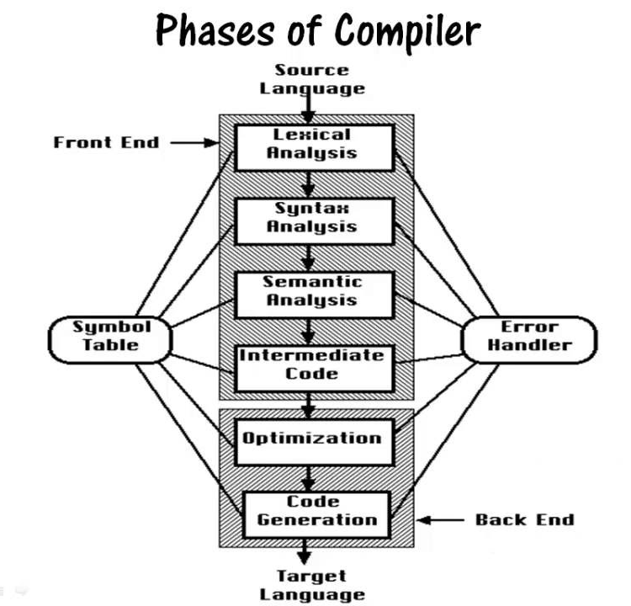
What did GCC do?
Compiler:
Compiles the pre-processed source code into assembly code for a specific processor.

Slide 15
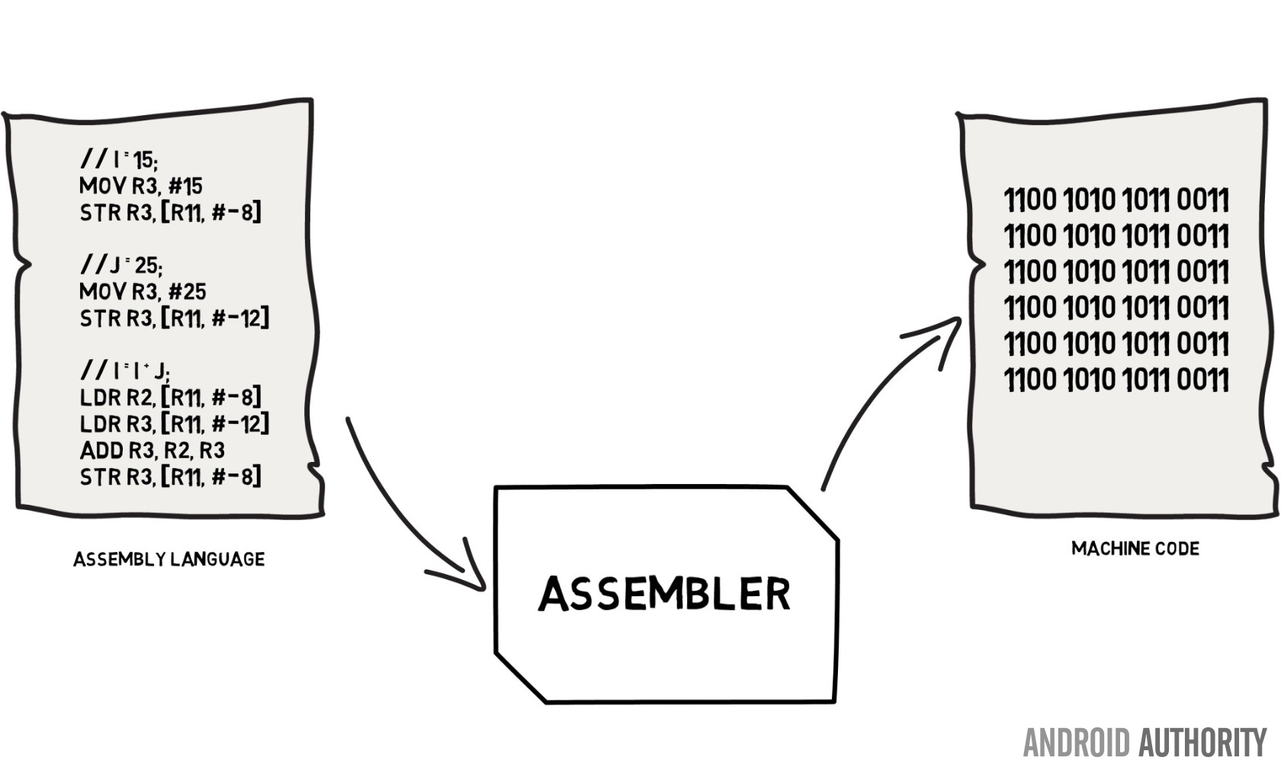
What did GCC do?
Assembler:
Converts the assembly code into machine code in the object file.

Slide 16
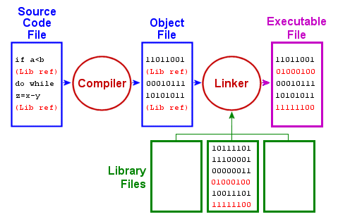
What did GCC do?
Linker:
Links the object code with the library code to produce an executable file “a.exe".

Slide 17
What did GCC do?
The result of the 4 stage process is the executable program.

Slide 18
LAB2 – Steps

Slide 19
Optional GCC parameters
When executing GCC a series of options can be provided to ensure the desired output, here are some examples:
The list of commands and behavior is very similar to IAR’s C compiler.

Slide 20
Additional utilities for compiler files
Some useful tools for analyzing compiled files:

Slide 21
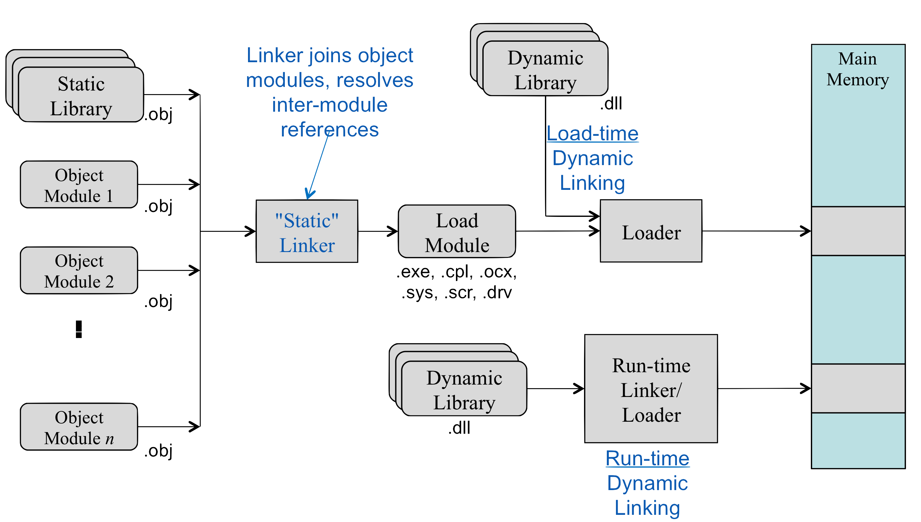
Dynamic libraries vs Static libraries

Slide 22
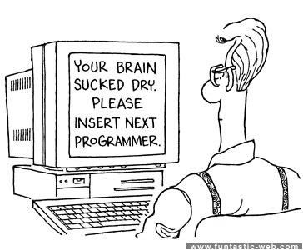
Compiling complex programs
Projects normally consist in more than one source code file thus manually building programs quickly becomes less of an option.

Slide 23
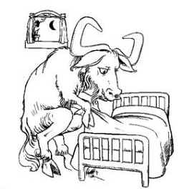
GNU Make
GNU Make is a tool which controls the generation of executables and other non-source files of a program from the program's source files.
Make gets its knowledge of how to build your program from a file called the makefile, which lists each of the non-source files and how to compute it from other files. When you write a program, you should write a makefile for it, so that it is possible to use Make to build and install the program.

Slide 24
GNU Make
Main features:
Details of compilation are listed in the file so you don’t need to know too much detail.
Figures out automatically which files it needs to update.
Is not limited to any particular language or compiler
It’s versatile is not limited to building a package, it can be used for anything else.
Make Rules and Targets:
target: dependencies ...
commands
...

Slide 25
LAB3 - make

Slide 26
Example:
all: hello.exe
hello.exe: hello.o
gcc -o hello.exe hello.o
hello.o: hello.c
gcc -c hello.c
clean:
rm hello.o hello.exe
Target
Prerequisites
Commands

Slide 27
Thank you.

Slide 28
Links and references:
C program memory layout http://www.geeksforgeeks.org/memory-layout-of-c-program/
Tutorial for GCC and make https://www3.ntu.edu.sg/home/ehchua/programming/cpp/gcc_make.html
Online compiler/visualizer https://godbolt.org/
x86_64 architecture https://en.wikibooks.org/wiki/X86_Assembly/X86_Architecture
Info about GCC project https://www.cse.iitb.ac.in/grc/intdocs/gcc-basic-info.html
Supported architectures list https://www.gnu.org/software/gcc/backends.html
History of C language http://csapp.cs.cmu.edu/3e/docs/chistory.html
Official GNU project site https://www.gnu.org/gnu/thegnuproject.en.html
Wiki-GNU project https://en.wikipedia.org/wiki/GNU_Project
Wiki-GNU Compiler Collection https://en.wikipedia.org/wiki/GNU_Compiler_Collection

Slide 29
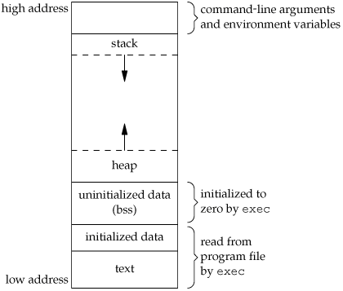
Additional information
Memory Layout of C Programs
A typical memory representation of C program consists of following sections.
1. Text segment 2. Initialized data segment 3. Uninitialized data segment 4. Stack 5. Heap

